Slide 1
Smiley Real Estate - Sales Performance Analysis
Joel Bravo
12/4/2025

Slide 2
Best Markets

Slide 3
Top 5 markets are determined by days on market, sales to list ratio, and closed listings rate
 | Market | Days on Market (Median) | Sale to List Ratio | Closed Listings Rate
1 | Buffalo, NY | 12 | 1.16 | 0.69
2 | Grand Rapids, MI | 14 | 1.01 | 0.70
3 | San Jose, CA | 17 | 1.03 | 0.63
4 | San Francisco, CA | 21 | 1.02 | 0.48
5 | Seattle, WA | 21 | 0.98 | 0.37
Days on Market (DOM): The top markets have short DOM, indicating high demand and a quick turnaround time on sales.
Sale to List Ratio: A measure of how closely listings are selling relative to their original selling price. A value of 1 indicates listings selling for their original price. 4 of the 5 top markets have a median selling price greater than the median listing price.
Closed Listings Rate: The proportion of closed listings relative to the amount of listings on the market. All 5 markets have robust closing rate, indicating a large volume of sales.
Takeaway: The best markets all have signals that indicate high levels of sales with quick turnaround times at higher prices. These are likely the most desirable markets for Smiley.

Slide 4
By comparison, the bottom 5 markets are weak in key metrics
 | Market | Days on Market (Median) | Sale to List Ratio | Closed Listings Rate
1 | Phoenix, AZ | 71 | 0.94 | 0.27
2 | San Antonio, TX | 83 | 0.94 | 0.13
3 | Jacksonville, FL | 85 | 0.98 | 0.22
4 | Austin, TX | 88 | 0.91 | 0.15
5 | Miami, FL | 92 | 0.94 | 0.15
High median DOM is common for the bottom 5 markets, with Miami having a Median DOM of 3 months.
Sale to List Ratio for 4 of the 5 markets is low enough to indicate that discounts were required to sell a listing. Jacksonville’s Sale to List Ratio was equivalent to Seattle and indicates a close to original price for closing.
All 5 markets have a low closed listings rate, indicating low demand and/or high inventory
Takeaway: With high DOM and a low closed listing rate, the bottom 5 markets are struggling to sell listings.

Slide 5
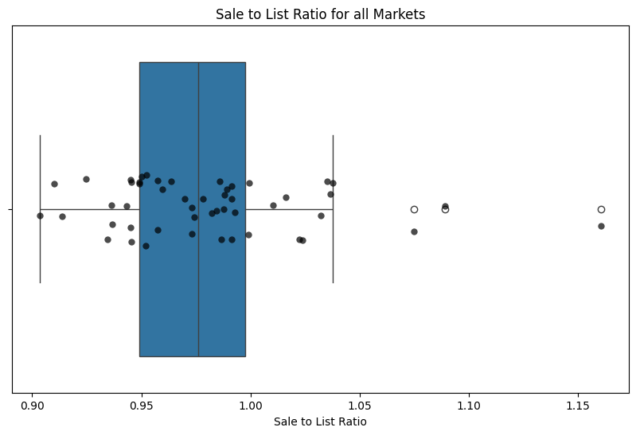
Notable trend: sale prices are dropping for most markets
75% of markets (black dots) have a sale to list ratio of under 1, indicating that the median listing is increasingly selling for under the original price.
More research is needed to determine if this is an emerging trend or following historic patterns, as well as whether other factors are at play for the reduced sale to list ratio.

Slide 6
Best Agents

Slide 7
Multiple metrics have to be balanced to determine the top agent in each market
Three metrics can be identified within agent performance data that can identify the top performing agent for a given market:
  Total Closing Ratio: The proportion of customers that resulted in a closed deal for the agent.
    Comparing the absolute number of closed deals between agents is not a reliable estimator given the differences in the amount of customers assigned per agent. Calculating the proportion of customers that led to a closed deal is a more effective way to determine agent effectiveness without dealing with outliers in customer counts.
  Weighted Average Customer Rating: The average customer rating of an agent weighted by average number of ratings.
    As the total number of customer ratings can vary significantly, a scenario could emerge where an agent with 1 rating has an average of 5.0 while another agent with 18 ratings has an average of 4.85. Bayesian shrinkage weighs agents with fewer reviewers closer to the global average rating, reducing the impact of outliers that can distort ratings.
  Combined Average Rank: The average from ranking Total Closing Ratio and Weighted Average Customer Rating.
    Agents with the highest value in Total Closing Ratio and Weighted Average Customer Rating have a rank of 1, with lower ratings have higher values. The average rank of agents in a market determines who the top performing agent is.

Slide 8
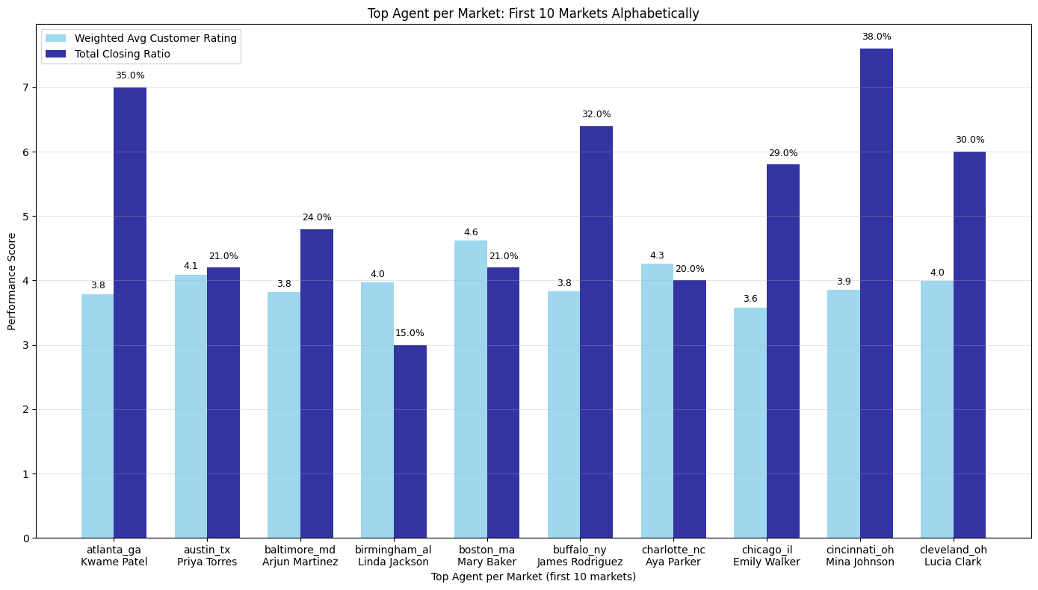
Top agent for the first 10 markets alphabetically*
* see appendix for full list of agents
Global Average Closed List Ratio: 25%
Global Average Customer Rating: 4.00

Slide 9
Sampling the first 10 top agents reveals what makes a top agent the best
The top agent in a given market is someone who does well in both converting customers to closed deals and in customer ratings. While there might be an agent who has a higher number of closed listings or a higher average rating, top agents achieve a balance others don’t and keep their overall performance high without letting anything slip.
Example:
  Individual top agents either approach or exceed the global average closed listings ratio (25%) and global average customer rating (4.00) compared to their in-market peers.
  An agent who might have a lower than average value in one metric is boosted by a stronger value elsewhere, though within their market they would still be the best performer.
Relationship between both metrics makes intuitive sense. It is unlikely that an agent with poor customer ratings would have a similarly high closed list ratio. Balancing both is critical to be a top agent.

Slide 10
Area for Growth

Slide 11
Comparing call logs to closed listings has potential for revealing new strategies
 | Unique Customer Calls (by Market) | Number of Closed Listings (by Market)
Minimum Value | 929 | 237
25% Percentile | 977 | 273
50% Percentile | 1003 | 282
75% Percentile | 1025 | 294
Max Value | 1061 | 323
Average Value | 1000 | 283
On average, markets have had 1000 unique customers calling and 283 closed listings for 2025.
  At a glance, markets with high call activity can be associated with a higher amount of closed listings, but there are exceptions.
  Ex: Salt Lake City has the highest number of unique callers (1061), but has less closed listings (293) then Seattle (323) and Las Vegas (313).
Is there a relationship between unique customer calls and closed listings that isn’t immediately apparent?

Slide 12
A moderately positive correlation exists between customer calls and closed listings
Pearson’s correlation is a statistical measure that measures the strength and relationship between two variables.
When measuring the relationship between unique customer calls and number of closed listings, Pearson’s correlation notes a moderately positive (0.429) statistically significant relationship between both values.
  Moderately positive means that markets with higher volumes of unique callers tend to have a moderately higher amount of closed listings.
  Other factors are likely influencing the increase of closed listings
Recommendation:
  It’s possible that markets with a smaller number of unique callers have potential for greater amounts of closed listings if unique callers are viewed as a proxy for interest in and knowledge of Smiley Real Estate. Focusing marketing efforts on markets with less than the average amount of unique callers could increase the number of closed listings.

Slide 13
Final Thoughts

Slide 14
What can be done with more time and resources?
Best Markets Analysis
  More data regarding housing construction activity, market economic strength (GDP, Area Median Income), migration rates, and more can provide a more comprehensive and long-term view on which markets are the best.
  Additional descriptive data could be used in a correlation matrix to determine what factors drive attributes such as days on market or closed listing rate. K-means clustering can group markets by common characteristics and trends, allowing for regional or group-level strategies.
Best Agents Analysis
  Incorporating historical agent data can reveal YoY changes in customer reviews and closing ratios. Agents who consistently improve in their closing ratios and reviews or keep them consistently high can be weighted towards a higher rank.
Areas for Growth Analysis
  More research is needed to see how much unique callers actually influence the number of closed listings.
    Segmenting markets into high-call and low-call groups and then running a T-test between them can reveal if high-call markets truly have higher amounts of closed listings.
    A regression model could indicate whether other variables are influencing closed listings instead of the number of unique callers.

Slide 15
What was my thought process?
First, identify the scope of the problem. The problems presented at a glance are simple, but their open-ended nature means there’s plenty of room for interpretation. For example, what makes someone a best agent? Unless I’ve had in-depth conversations with stakeholders and SMEs, this will be a judgement call on my part that’s informed by the available data. This also means knowing when something is ‘good enough’ without chasing perfection and new directions forever.
Second, Inspect the data. My preferred tool for this is python given its flexibility and ability to ingest data from sources as varied as spreadsheets, APIs, and complex queries. I can review the data source and run some descriptive statistics to understand the scope and shape of the data. I can also use this time to narrow the scope of my problem by discovering what the data can or can’t let me do.
Third, research the problem. My experience in past roles has given me insight of how to proceed in many cases, like knowing how to use multiple performance metrics to rank something or determining the statistical relationship between two groups. In cases where I had multiple options to pursue or was unsure of domain-specific analysis techniques, I used AI tools (my preferred tool is Perplexity) to brainstorm ways to tackle the problem and theories to test out.

Slide 16
What was my thought process? - continued
Fourth, code: the most straightforward step was ironically the most technical part. I used python to manipulate the data in a way that’s useful for my analysis, create new features such as sale to list ratio and weighted average customer rating that could reveal new insights, and generate visualizations to compliment my analysis.
Fifth, interpret the results: My analysis won’t be useful to anyone if I can’t convert technical information into easy to understand results for non-technical stakeholders. Similarly, if there isn’t a clear takeaway then there isn’t much of a point to the analysis. A slide deck provides a high-level overview of the questions posed and the key takeaways and recommendations that spring from them.

Slide 17
Appendix

Slide 18
Top 5 markets with expanded information
 | Market | Days on Market (Meidan) | New Listing Price (Median) | Closing Price (Median) | Sale to List Ratio | Listings on Market | Closed Listings | Closed Listings Rate
1 | Buffalo, NY | 12 | $249,900 | $290,000 | 1.16 | 1475 | 1026 | 0.69
2 | Grand Rapids, MI | 14 | $349,900 | $355,500 | 1.01 | 1905 | 1342 | 0.70
3 | San Jose, CA | 17 | $1,573,032 | $1,632,174 | 1.03 | 1698 | 1082 | 0.63
4 | San Francisco, CA | 21 | $1,450,000 | $1,482,500 | 1.02 | 6265 | 3069 | 0.48
5 | Seattle, WA | 21 | $843,328 | $832,871 | 0.98 | 9813 | 3716 | 0.37

Slide 19
Top agents for each market
 | Agent | Market | Total Closing Ratio | Weighted Avg Customer Rating | Combined Avg Rank
1 | Kwame Patel | atlanta_ga | 0.35 | 3.79 | 2
2 | Priya Torres | austin_tx | 0.21 | 4.09 | 3.25
3 | Arjun Martinez | baltimore_md | 0.24 | 3.82 | 2
4 | Linda Jackson | birmingham_al | 0.15 | 3.97 | 4.25
5 | Mary Baker | boston_ma | 0.21 | 4.62 | 2.5
6 | James Rodriguez | buffalo_ny | 0.32 | 3.83 | 2.5
7 | Aya Parker | charlotte_nc | 0.2 | 4.26 | 2.5
8 | Emily Walker | chicago_il | 0.29 | 3.58 | 3
9 | Mina Johnson | cincinnati_oh | 0.38 | 3.85 | 3.5
 | Agent | Market | Total Closing Ratio | Weighted Avg Customer Rating | Combined Avg Rank
10 | Lucia Clark | cleveland_oh | 0.3 | 3.99 | 1.5
11 | Charles Adams | columbus_oh | 0.21 | 3.58 | 3.25
12 | Emily Adams | dallas_tx | 0.34 | 3.77 | 4.5
13 | Omar Adams | denver_co | 0.17 | 4.19 | 3.75
14 | Barbara Young | detroit_mi | 0.25 | 4.4 | 2.75
15 | Mina Hill | fresno_ca | 0.22 | 4.2 | 2.5
16 | Zainab Ramirez | grand_rapids_mi | 0.26 | 4.18 | 3.25
17 | Thomas Nelson | houston_tx | 0.22 | 4.32 | 1.25
18 | Margaret Tran | indianapolis_in | 0.28 | 3.96 | 4

Slide 20
Top agents for each market - continued
 | Agent | Market | Total Closing Ratio | Weighted Avg Customer Rating | Combined Avg Rank
19 | Camila Lopez | jacksonville_fl | 0.19 | 4.19 | 3.5
20 | Ebony Perez | kansas_city_mo | 0.29 | 3.5 | 3
21 | Jessica Garcia | las_vegas_nv | 0.21 | 4.13 | 3
22 | Keisha Smith | los_angeles_ca | 0.22 | 3.81 | 2.5
23 | Hassan Carter | louisville_ky | 0.29 | 4.25 | 3
24 | Christopher Patel | memphis_tn | 0.22 | 3.99 | 2.25
25 | Lakshmi Mitchell | miami_fl | 0.21 | 4.21 | 3.25
26 | Yuki Gonzalez | milwaukee_wi | 0.32 | 3.39 | 4
27 | Charles Hall | minneapolis_mn | 0.29 | 3.92 | 1.5
 | Agent | Market | Total Closing Ratio | Weighted Avg Customer Rating | Combined Avg Rank
28 | Christopher Hall | nashville_tn | 0.21 | 4.29 | 3.75
29 | Jin Harris | new_york_ny | 0.3 | 3.78 | 2.5
30 | Jamal Thompson | oklahoma_city_ok | 0.34 | 3.56 | 3.25
31 | David Nelson | orlando_fl | 0.22 | 4.14 | 2.25
32 | Michael Lewis | orlando_fla | 0.12 | 3.73 | 1
33 | Ali Walker | philadelphia_pa | 0.28 | 4.11 | 2
34 | Richard Harris | phoenix_az | 0.2 | 4.26 | 2.25
35 | Maria Lewis | pittsburgh_pa | 0.23 | 4.21 | 2.75
36 | Aya Patel | portland_or | 0.17 | 3.79 | 3.25

Slide 21
Top agents for each market - continued
 | Agent | Market | Total Closing Ratio | Weighted Avg Customer Rating | Combined Avg Rank
37 | Keisha Khan | providence_ri | 0.19 | 3.92 | 6
38 | Raj Hill | raleigh_nc | 0.39 | 4.39 | 1
39 | Margaret Baker | richmond_va | 0.31 | 4.26 | 2
40 | Carlos Young | riverside_ca | 0.37 | 3.97 | 2
41 | Ahmad Walker | sacramento_ca | 0.28 | 4.11 | 2
42 | Linda Washington | salt_lake_city_ut | 0.27 | 3.89 | 2
43 | Richard Lewis | san_antonio_tx | 0.25 | 3.83 | 3.75
44 | Tyrone Walker | san_diego_ca | 0.33 | 4.01 | 2.5
45 | Haruka Smith | san_francisco_ca | 0.2 | 4.18 | 4
 | Agent | Market | Total Closing Ratio | Weighted Avg Customer Rating | Combined Avg Rank
46 | Patricia Campbell | san_jose_ca | 0.23 | 4 | 2.5
47 | William King | seattle_wa | 0.36 | 3.96 | 2.5
48 | Mary Hill | st_louis_mo | 0.2 | 3.73 | 4
49 | Lakshmi Washington | tampa_fl | 0.25 | 4.02 | 2.75
50 | Omar Nelson | virginia_beach_va | 0.24 | 4.26 | 3.75

